Slide 1
IPv4 and IPv6
Header format
20.<number>

Slide 2
20-1 INTERNETWORKING
In this section, we discuss internetworking, connecting networks together to make an internetwork or an internet.
Topics discussed in this section:
Need for Network Layer
Internet as a Datagram Network
Internet as a Connectionless Network
20.<number>

Slide 3

Figure 20.1 Links between two hosts
20.<number>

Slide 4

Figure 20.2 Network layer in an internetwork
20.<number>

Slide 5

Figure 20.3 Network layer at the source, router, and destination
20.<number>

Slide 6

Figure 20.3 Network layer at the source, router, and destination (continued)
20.<number>

Slide 7

Note
Switching at the network layer in the Internet uses the datagram approach to packet switching.
20.<number>

Slide 8
Note
Communication at the network layer in the Internet is connectionless.
20.<number>

Slide 9
IPv4
The Internet Protocol version 4 (IPv4) is the delivery mechanism used by the TCP/IP protocols.
20.<number>

Slide 10

Position of IPv4 in TCP/IP protocol suite

Slide 11

IPv4 datagram format
20.<number>

Slide 12

Header Length :
multiple sized headers so we need this field.
Header will always be a multiple of 4 bytes and so we can have a maximum length of the field as 15, so the maximum size of the header is 60 bytes ( 20 bytes are mandatory ).
Type Of Service (ToS) : This helps the router in taking the right routing decisions. The structure is :
First three bits : They specify the precedences i.e. the priority of the packets.
Next three bits :
  D bit - D stands for delay. If the D bit is set to 1, then this means that the application is delay sensitive, so we should try to route the packet with minimum delay.
  T bit - T stands for throughput. This tells us that this particular operation is throughput sensitive.
  R bit - R stands for reliability. This tells us that we should route this packet through a more reliable network.
Last two bits: The last two bits are never used.
20.<number>

Slide 13
ID Field : The source and ID field together will represent the fragments of a unique packet. So each fragment will have a different ID.
Offset : It is a 13 bit field that represents where in the packet, the current fragment starts. Each bit represents 8 bytes of the packet. So the packet size can be at most 64 kB. Every fragment except the last one must have its size in bytes as a multiple of 8 in order to ensure compliance with this structure.
Flags :It has three bits -
  M bit : If M is one, then there are more fragments on the way and if M is 0, then it is the last fragment
  DF bit : If this bit is sent to 1, then we should not fragment such a packet.
  Reserved bit : This bit is not used.
20.<number>

Slide 14
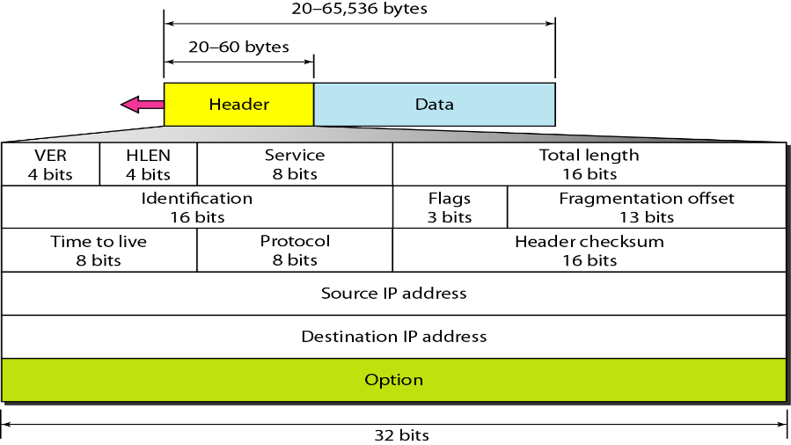
Total Length : It includes the IP header and everything that comes after it.
Time To Live (TTL) : Using this field, we can set the time within which the packet should be delivered or else destroyed. It is strictly treated as the number of hops.
Protocol : This specifies the module to which we should hand over the packet ( UDP or TCP ). It is the next encapsulated protocol.
Header Checksum : This is the usual checksum field used to detect errors. Since the TTL field is changing at every router so the header checksum ( upto the options field ) is checked and recalculated at every router.
Source : It is the IP address of the source node
Destination : It is the IP address of the destination node.
IP Options : The options field was created in order to allow features to be added into IP as time passes and requirements change.
20.<number>

Slide 15

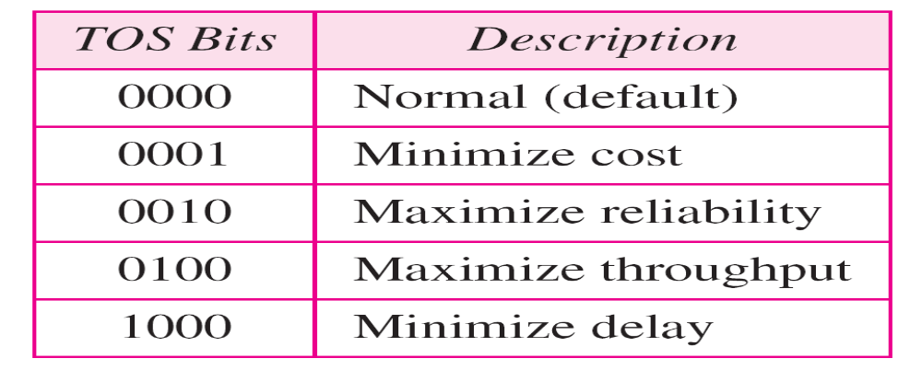
Service type or differentiated services
20.<number>

Slide 16
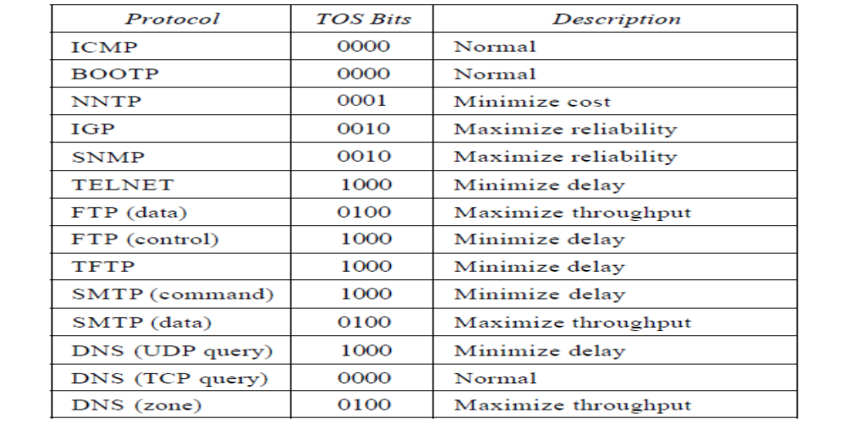
20.<number>

Slide 17
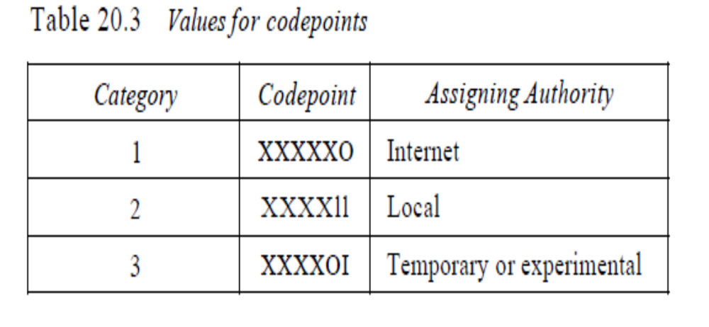
20.<number>

Slide 18
The total length field defines the total length of the datagram including the header.
20.<number>

Slide 19

Encapsulation of a small datagram in an Ethernet frame
20.<number>

Slide 20

Protocol field and encapsulated data
20.<number>

Slide 21

Protocol values
20.<number>

Slide 22
An IPv4 packet has arrived with the first 8 bits as shown:
01000010
The receiver discards the packet. Why?
Solution
There is an error in this packet. The 4 leftmost bits (0100) show the version, which is correct. The next 4 bits (0010) show an invalid header length (2 × 4 = 8). The minimum number of bytes in the header must be 20. The packet has been corrupted in transmission.
20.<number>

Slide 23
In an IPv4 packet, the value of HLEN is 1000 in binary. How many bytes of options are being carried by this packet?
Solution
The HLEN value is 8, which means the total number of bytes in the header is 8 × 4, or 32 bytes. The first 20 bytes are the base header, the next 12 bytes are the options.
20.<number>

Slide 24

Maximum transfer unit (MTU)
20.<number>

Slide 25

MTUs for some networks
20.<number>

Slide 26

Flags used in fragmentation
20.<number>

Slide 27
Fragmentation
A datagram can travel through different networks. Each router decapsulates the IPv4 datagram from the frame it receives, processes it, and then encapsulates it in another frame.
The format and size of the received frame depend on the protocol used by the physical network through which the frame has just traveled.
The format and size of the sent frame depend on the protocol used by the physical network through which the frame is going to travel.
For example, if a router connects a LAN to a WAN, it receives a frame in the LAN format and sends a frame in the WAN format.
20.<number>

Slide 28
Fields Related to Fragmentation
The fields that are related to fragmentation and reassembly of an IPv4 datagram are the identification, flags, and fragmentation offset fields.
Identification. This 16-bit field identifies a datagram originating from the source host.
The combination of the identification and source IPv4 address must uniquely define a datagram as it leaves the source host.
Flags. This is a 3-bit field. The first bit is reserved. The second bit is called the do not fragment bit. If its value is 1, the machine must not fragment the datagram.
Fragmentation offset. This 13-bit field shows the relative position of this fragment with respect to the whole datagram. It is the offset of the data in the original datagram measured in units of 8 bytes.
20.<number>

Slide 29
Fragementation
Even if each fragment follows a different path and arrives out of order, the final destination host can reassemble the original datagram from the fragments received (if none of them is lost) by using the following strategy:
The first fragment has an offset field value of zero.
Divide the length of the first fragment by 8. The second fragment has an offset value equal to that result.
Divide the total length of the first and second fragments by 8.
The third fragment has an offset value equal to that result.
Continue the process. The last fragment has a more bit value of O.
20.<number>

Slide 30

Fragmentation example
Identifies sequence of frames using the fragment offset(13 bits) field in IP header
20.<number>

Slide 31

Detailed fragmentation example
20.<number>

Slide 32

Example of checksum calculation in IPv4
20.<number>

Slide 33
Example 20.5
A packet has arrived with an M bit value of 0. Is this the first fragment, the last fragment, or a middle fragment? Do we know if the packet was fragmented?
Solution
If the M bit is 0, it means that there are no more fragments; the fragment is the last one. However, we cannot say if the original packet was fragmented or not. A non-fragmented packet is considered the last fragment.
20.<number>

Slide 34
Example 20.6
A packet has arrived with an M bit value of 1. Is this the first fragment, the last fragment, or a middle fragment? Do we know if the packet was fragmented?
Solution
If the M bit is 1, it means that there is at least one more fragment. This fragment can be the first one or a middle one, but not the last one. We don’t know if it is the first one or a middle one; we need more information (the value of the fragmentation offset).
20.<number>

Slide 35
Example 20.7
A packet has arrived with an M bit value of 1 and a fragmentation offset value of 0. Is this the first fragment, the last fragment, or a middle fragment?
Solution
Because the M bit is 1, it is either the last fragment or a middle one. Because the offset value is 0, it is the first fragment.
20.<number>

Slide 36
Example 20.8
A packet has arrived in which the offset value is 100. What is the number of the first byte? Do we know the number of the last byte?
Solution
To find the number of the first byte, we multiply the offset value by 8. This means that the first byte number is 800. We cannot determine the number of the last byte unless we know the length.
20.<number>

Slide 37
Example 20.9
A packet has arrived in which the offset value is 100, the value of HLEN is 5, and the value of the total length field is 100. What are the numbers of the first byte and the last byte?
Solution
The first byte number is 100 × 8 = 800. The total length is 100 bytes, and the header length is 20 bytes (5 × 4), which means that there are 80 bytes in this datagram. If the first byte number is 800, the last byte number must be 879.
20.<number>

Slide 38
Example 20.10
Figure 20.13 shows an example of a checksum calculation for an IPv4 header without options. The header is divided into 16-bit sections. All the sections are added and the sum is complemented. The result is inserted in the checksum field.
20.<number>

Slide 39
20.<number>

Slide 40
20.<number>

Slide 41
Efficiency (e) = useful/total = (Data without header)/(Data with header)
Throughput = e * B { where B is bottleneck bandwidth }
An IP router with a Maximum Transmission Unit (MTU) of 200 bytes has received an IP packet of size 520 bytes with an IP header of length 20 bytes. The values of the relevant fields in the IP header.
20.<number>

Slide 42
MTU is 200 bytes and 20 bytes is header size so,
maximum length of data = 180 bytes
but it can be represented in fragment offset since not divisible by 8 so,
maximum length of data feasible = 176 bytes.
Number of fragments = (520/200) = 3.
Header length = 5 (since scaling factor is 4 therefore, 20/4 = 5)
Efficiency, e = (Data without header)/(Data with header) = 500/560 = 89.2 %
20.<number>

Slide 43
20.<number>

Slide 44
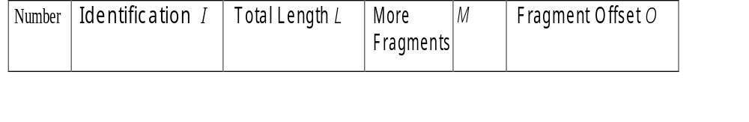
Consider sending a 3,000 byte datagram into a link which has an MTU of 500 bytes. Suppose the original datagram is stamped with the identification number 422. How many fragments are generated? What are their characteristics?
20.<number>

Slide 45
Assume that the DF flag was not set : )
Assume that no optional fields of the IP header are in use (i.e. IP header is 20 bytes)
The original datagram was 3000 bytes, subtracting 20 bytes for header, that leaves 2980 bytes of data.
Assume the ID of the original packet is 'x'
With an MTU of 500 bytes, 500 - 20 = 480 bytes of data may be transmitted in each packet
Therefore, ceiling(2980 / 480) = 7 packets are needed to carry the data.
The packets will have the following characteristics (NOTE: offset is measured in 8 byte blocks, you don't need to specify Total_len)
Packet 1: ID=x, Total_len=500, MF=1, Frag_offset=0
Packet 2: ID=x, Total_len=500, MF=1, Frag_offset=60
Packet 3: ID=x, Total_len=500, MF=1, Frag_offset=120
Packet 4: ID=x, Total_len=500, MF=1, Frag_offset=180
Packet 5: ID=x, Total_len=500, MF=1, Frag_offset=240
Packet 6: ID=x, Total_len=500, MF=1, Frag_offset=300
Packet 7: ID=x, Total_len=120, MF=0, Frag_offset=360

Slide 46
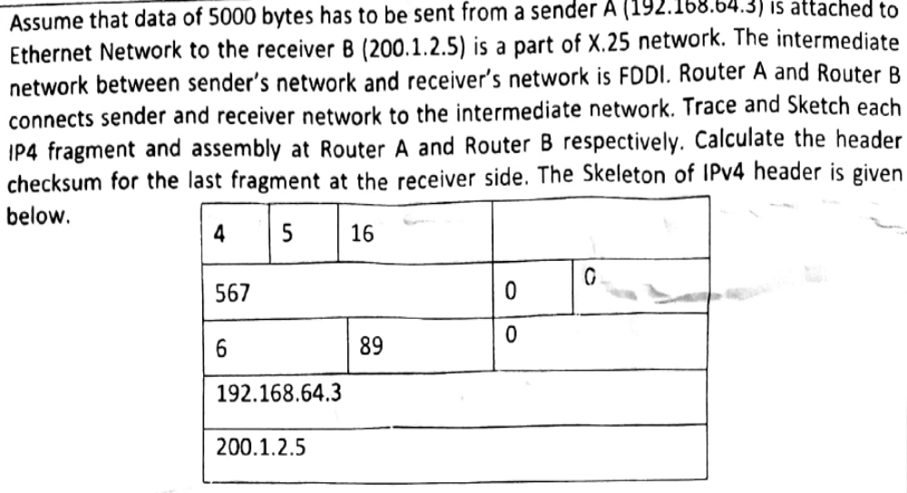
20.<number>

Slide 47
In an IPv4 datagram, the M bit is 0, the value of HLEN is 10, the value of total length is 400 and the fragment offset value is 300. The position of the datagram, the sequence numbers of the first and the last bytes of the payload, respectively are
(A) Last fragment, 2400 and 2789
(B) First fragment, 2400 and 2759
(C) Last fragment, 2400 and 2759
(D) Middle fragment, 300 and 689
20.<number>

Slide 48
Explanation:
M = 0 indicates that this packet is the last packet among all fragments of original packet. So the answer is either A or C.
It is given that HLEN field is 10. Header length is number of 32 bit words.
So header length = 10 * 4 = 40
Also, given that total length = 400.
Total length indicates total length of the packet including header.
So, packet length excluding header = 400 – 40 = 360
Last byte address = 2400 + 360 – 1 = 2759 (Because numbering starts from 0)
20.<number>

Slide 49
An IP router with a Maximum Transmission Unit (MTU) of 1500 bytes has received an IP packet of size 4404 bytes with an IP header of length 20 bytes. The values of the relevant fields in the header of the third IP fragment generated by the router for this packet are
(A) MF bit: 0, Datagram Length: 1444; Offset: 370
(B) MF bit: 1, Datagram Length: 1424; Offset: 185
(C) MF bit: 1, Datagram Length: 1500; Offset: 37
(D) MF bit: 0, Datagram Length: 1424; Offset: 2960
20.<number>

Slide 50
Number of packet fragments = ⌈ (total size of packet)/(MTU) ⌉
= ⌈ 4404/1500 ⌉
= ⌈ 2.936 ⌉
= 3
So Datagram with data 4404 byte fragmented into 3 fragments.
The first frame carries bytes 0 to 1479 (because MTU is 1500 bytes and HLEN is 20 byte so the total bytes in fragments is maximum 1500-20=1480). the offset for this datagram is 0/8 = 0.
20.<number>

Slide 51
Host A sends a UDP datagram containing 8880 bytes of user data to host B over an Ethernet LAN. Ethernet frames may carry data up to 1500 bytes (i.e. MTU = 1500 bytes). Size of UDP header is 8 bytes and size of IP header is 20 bytes. There is no option field in IP header. How may total number of IP fragments will be transmitted and what will be the contents of offset field in the last fragment?
(A) 6 and 925
(B) 6 and 7400
(C) 7 and 1110
(D) 7 and 8880
20.<number>

Slide 52
UDP data = 8880 bytes
UDP header = 8 bytes
IP Header = 20 bytes
Total Size excluding IP Header = 8888 bytes.
Number of fragments = ⌈ 8888 / 1480 ⌉
= 7
Refer the Kurose book slides on IP (Offset is always scaled by 8)
Offset of last segment = (1480 * 6) / 8 = 1110
20.<number>

Slide 53
IPv6
The network layer protocol in the TCP/IP protocol suite is currently IPv4. Although IPv4 is well designed, data communication has evolved since the inception of IPv4 in the 1970s. IPv4 has some deficiencies that make it unsuitable for the fast-growing Internet.
20.<number>

Slide 54

IPv6 datagram header and payload
20.<number>

Slide 55

Format of an IPv6 datagram
20.<number>

Slide 56

Next header codes for IPv6
20.<number>

Slide 57

Priorities for congestion-controlled traffic
20.<number>

Slide 58

Priorities for noncongestion-controlled traffic
20.<number>

Slide 59
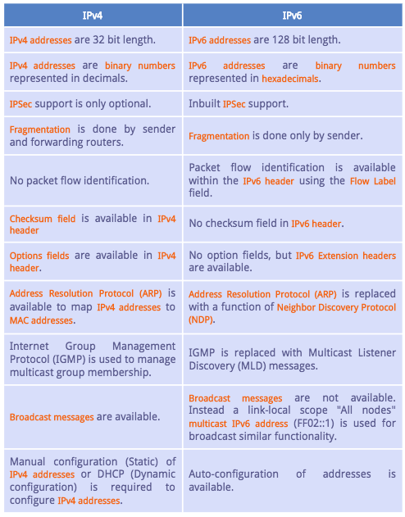
20.<number>

Slide 60

Comparison between IPv4 and IPv6 packet headers
20.<number>

Slide 61

Extension header types
20.<number>

Slide 62
Comparison between IPv4 options and IPv6 extension headers
20.<number>

Slide 63
TRANSITION FROM IPv4 TO IPv6
Because of the huge number of systems on the Internet, the transition from IPv4 to IPv6 cannot happen suddenly. It takes a considerable amount of time before every system in the Internet can move from IPv4 to IPv6. The transition must be smooth to prevent any problems between IPv4 and IPv6 systems.
Topics discussed in this section:
Dual Stack
Tunneling
Header Translation
20.<number>

Slide 64

Three transition strategies
20.<number>

Slide 65

Dual stack
20.<number>

Slide 66

Tunneling strategy
20.<number>

Slide 67

Header translation strategy
20.<number>

Slide 68
Header translation
20.<number>

